Slide 1
Analysis and Predictions on the Ames Housing Market

Slide 2
Agenda
Discovery questions on the Ames, Iowa housing dataset

Slide 3
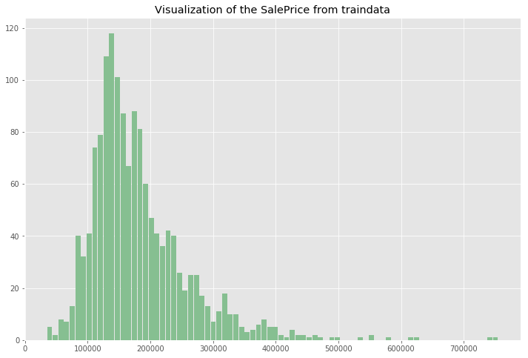
How much does it cost to buy a house in the city of Ames?
Notes:
The cheapest price is $34,900. The most expensive price is $755,000. The average sold price is $180,921. The median sold price is $163,000.

Slide 4
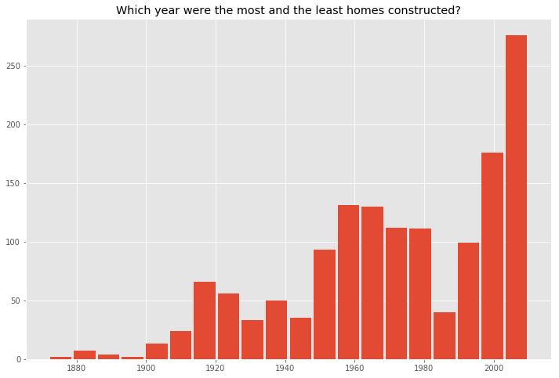
Residential Development in Ames
Notes:
The first home was built in the year 1872. The most recent home was built in the year 2010. Most of the homes were built in the 50s, 60s, 70s, ,80s and 2000s.

Slide 5
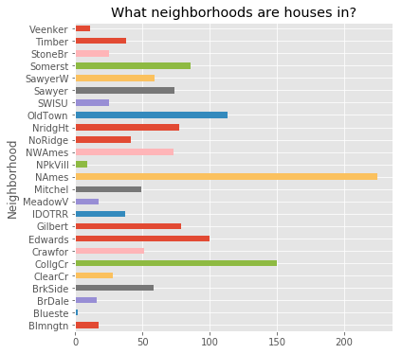
Most Popular Neighborhoods in Ames
Notes:
North Ames, Collect Creek, and Old Town, with few houses in Bluestem, Northpark Villa and Veenker.

Slide 6
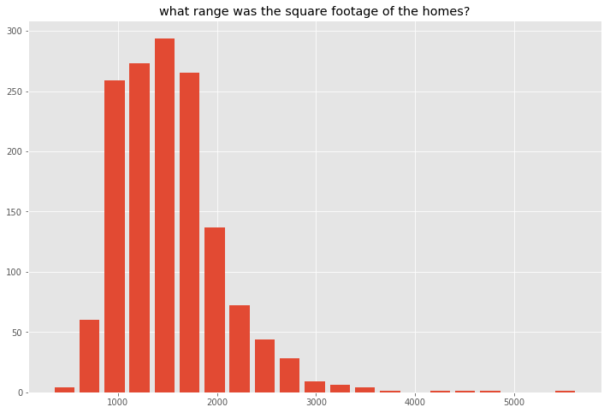
What was the most popular home size?
Notes:
The largest square footage home sold was 5,642 sq ft and the smallest square footage home sold was 334 sq ft. The average square footage of a sold home was 1,515 sq ft The median square footage of a sold home was 1,464 sq ft.

Slide 7
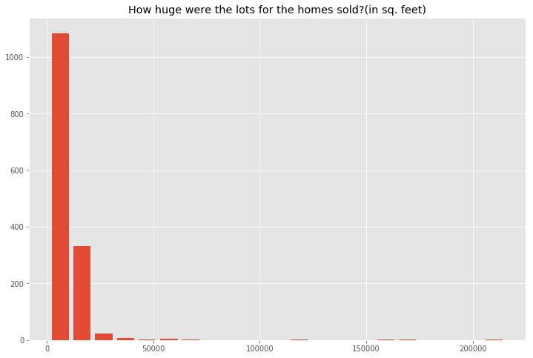
What range were the home lot sizes?
Notes:
The average lot size of the sold home is 10,517 sq ft The median lot size of the sold home is 9,478 sq ft The biggest lot size of the sold home is 215,245 sq ft The smallest lot size of the sold home is 1,300 sq ft.

Slide 8
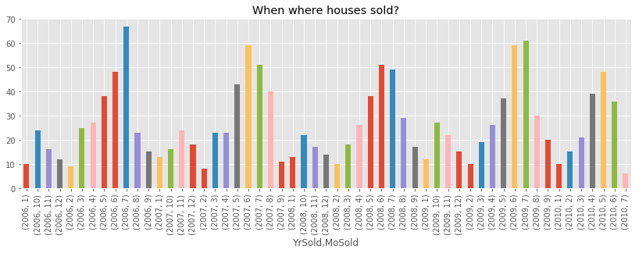
Busiest season for selling homes in Ames
Notes:
We observe a seasonal pattern with sales high in June and July. The season picks up in March.

Slide 9
Analysis with variables
Univariate Analysis
Bivariate Analysis
Check for missing values
Feature selection based on Correlation Check
Notes:
Checked normality for every numeric variable - We observe some of the numeric features are positively skewed such as LotFrontage, LotArea, BsmtUnfSF, TotalBsmtSF,1stFlrSF, GrLivArea and GarageArea.
Converting 3 numeric variables to categorical variables for the dataset as they actually function as a class- MSSubClass, MoSold, YrSold
For categorical variables, drew count plots to observe highly overpresented data.
A number of categorical features actually contain ranked information in them and should thus be converted to discrete quantitative features.
Lets select these nominal kind of features - Alley, LotShape, LandContour, Utilities, LandSlope, ExterQual, ExterCond, BsmtQual, BsmtCond, BsmtExposure, BsmtFinType1, BsmtFinType2,
HeatingQC, KitchenQual, Functional, FireplaceQu, GarageFinish, GarageQuality, GarageCond, PavedDrive, PoolQC
Filling in the missing values in the dataframes with 0
Correlation – Selected features based on correlation
converted_features = ['Alley','LotShape','LandContour','Utilities','LandSlope','ExterQual','ExterCond', 'BsmtQual','BsmtCond','BsmtExposure','BsmtFinType1','BsmtFinType2','HeatingQC', 'KitchenQual','Functional','FireplaceQu','GarageFinish','GarageQual', 'GarageCond','PavedDrive','PoolQC’]
Dropped features -

Slide 10
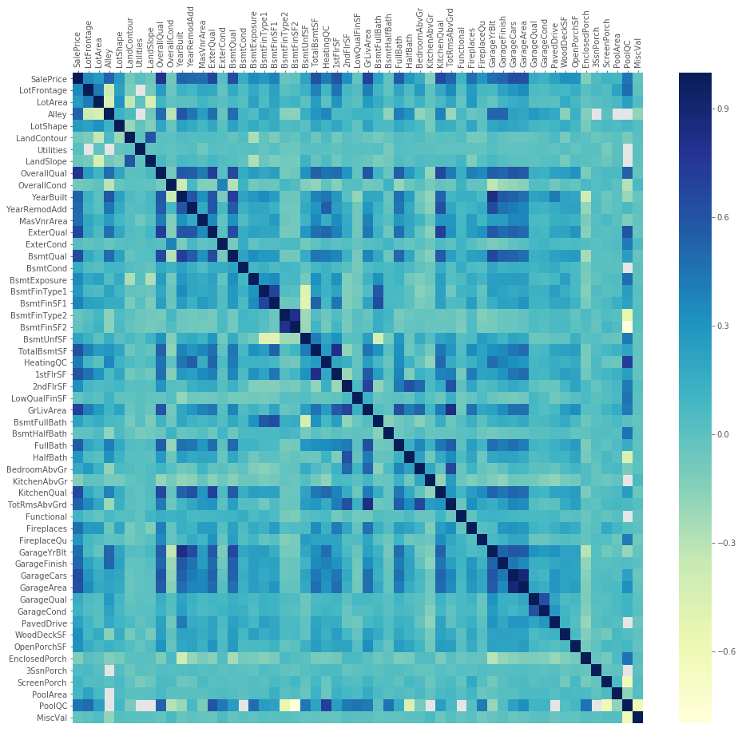
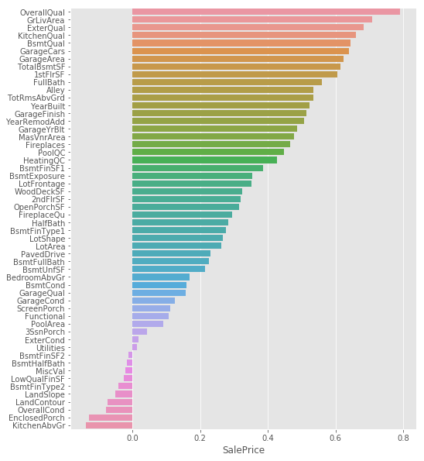
Correlation Matrix
Notes:
we find that GarageYrBlt is highly correlated with
# YearBuilt, which means that garages were built along with the house.
# BsmtQual correlates with OverallQual and TotalBsmtSF correlates highly with 1stFlrSF,
# which both make a lot of sense. We also see that KitchenQual correlates highly with
# ExteriorQual.GarageCars and GarageArea are highly correlated so we can drop GarageArea

Slide 11
Multiple Regression Model in R
Notes:
Checked normality for every numeric variable - We observe some of the numeric features are positively skewed such as LotFrontage, LotArea, BsmtUnfSF, TotalBsmtSF,1stFlrSF, GrLivArea and GarageArea.
Converting 3 numeric variables to categorical variables for the dataset as they actually function as a class- MSSubClass, MoSold, YrSold
For categorical variables, drew count plots to observe highly overpresented data.
A number of categorical features actually contain ranked information in them and should thus be converted to discrete quantitative features.
Lets select these nominal kind of features - Alley, LotShape, LandContour, Utilities, LandSlope, ExterQual, ExterCond, BsmtQual, BsmtCond, BsmtExposure, BsmtFinType1, BsmtFinType2,
HeatingQC, KitchenQual, Functional, FireplaceQu, GarageFinish, GarageQuality, GarageCond, PavedDrive, PoolQC
Filling in the missing values in the dataframes with 0
Correlation – Selected features based on correlation
converted_features = ['Alley','LotShape','LandContour','Utilities','LandSlope','ExterQual','ExterCond', 'BsmtQual','BsmtCond','BsmtExposure','BsmtFinType1','BsmtFinType2','HeatingQC', 'KitchenQual','Functional','FireplaceQu','GarageFinish','GarageQual', 'GarageCond','PavedDrive','PoolQC’]
Dropped features -

Slide 12
Multiple Linear Regression Model in R
Procedures used:
Forward Regression with BIC <= Best model
Forward Regression with AIC <= Poor Performing model
Backward Regression with BIC <= Second Best model
Backward Regression with AIC <= Poor Performing model

Slide 13
Multiple Linear Regression Model in R
Data Cleaning:
Categorical variables in the Train data set have NAs that represent a factor of ‘None’ => converted to ‘None’
Categorical variables in the Test data set have NAs that were imputed primarily using mode, or frequency of occurrence
Caret library was used for imputing the numerical variables using KNN (K Nearest Neighbors) method in the Train data set, K = 38
The numerical data in Test was imputed using KNN imputation from the Training data as a base

Slide 14
Multiple Linear Regression Model in R
Feature Engineering and Data Transformations:
Corrected for skewness in the dependent variable Sale Price: log transformation was used
Corrected for a right skewed data distribution: the independent variables were transformed using sqrt(x), as log 0 is undefined
KNN imputation in R included scaling (standardization) of all of the numerical variables
Like variables such as Condition1, Condition2, and Exterior1, Exterior2 were combined

Slide 15
Multiple Linear Regression Model in R
Feature Engineering and Data Transformations (Cont’d):
Additional levels were added and grouped for categorical variables in the Test data set, to make them aligned to the Trained data set
YrsAge and RemodeledYrs were created from YearBuilt, YrSold & YearRemodAdd variables
Variables that are correlated to the feature engineered variables or that are redundant were dropped
Categorical variables were dummified in the regression model

Slide 16
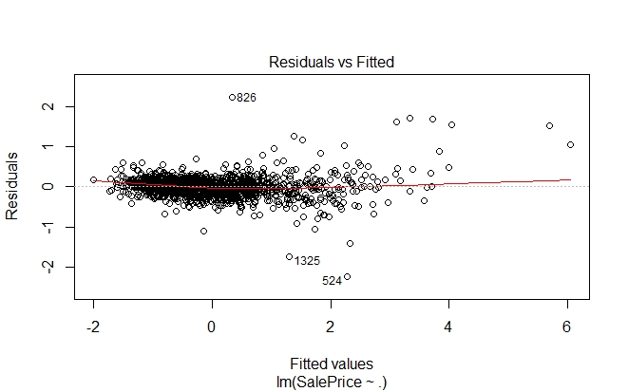
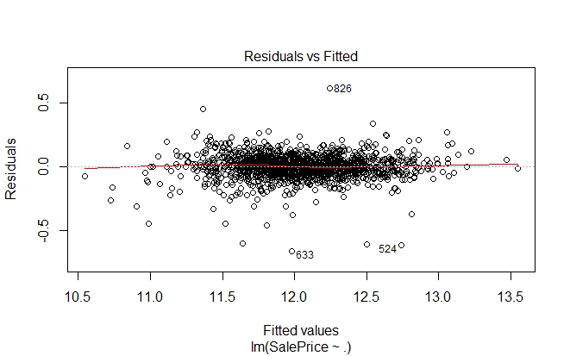
Multiple Linear Regression Model in R
Feature Engineering Outcomes (Linearity):
Before Transformations After Transformations

Slide 17
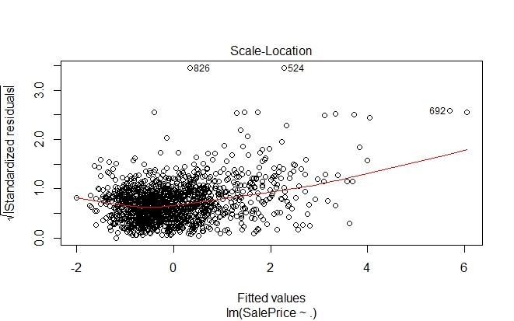
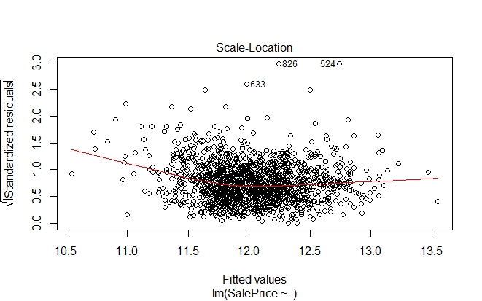
Multiple Linear Regression Model in R
Feature Engineering Outcomes (Constant Variance):
Before Transformations After Transformations

Slide 18
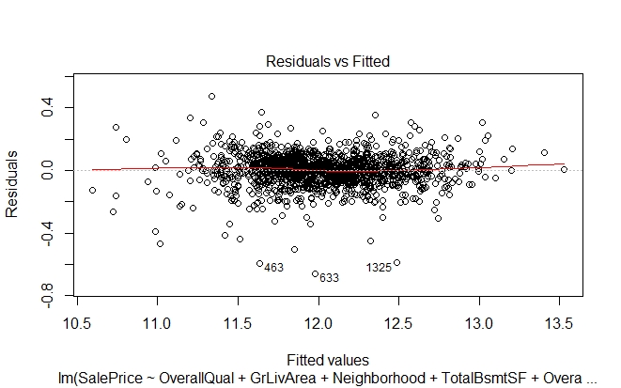
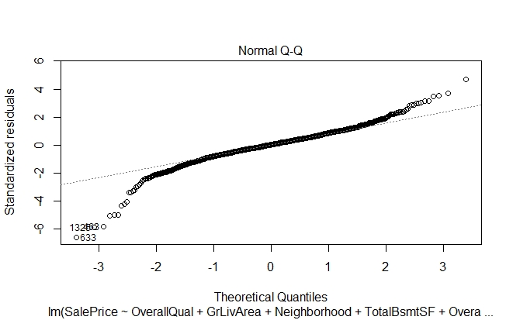
Multiple Linear Regression Model in R
Forward Stepwise Model Selection (BIC) on Full Train Data:

Slide 19
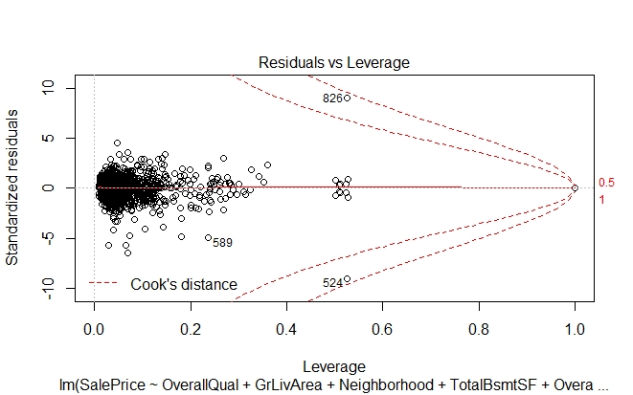
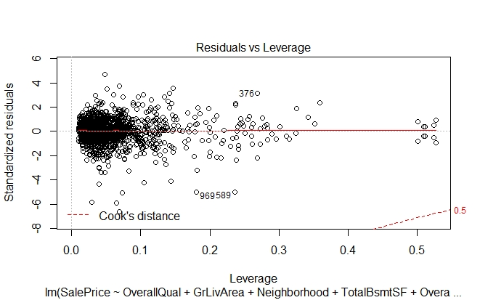
Multiple Linear Regression Model in R
Forward Stepwise Model Selection (BIC) on Full Train Data:
Removal of Outliers

Slide 20
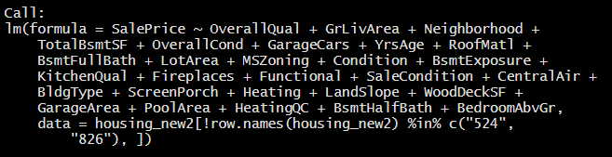

Multiple Linear Regression Model in R
Forward Stepwise Selection (BIC) Model Outcome:
Particularly significant to the model are these variables:
Overall Quality, Above Grade Living Area SF, Neighborhoods of Crawford and Sommerset, Roof Material, Sale Condition, and Kitchen Quality, all of which in higher qualities, increases the Sale Price on average.
Single Family Detached homes
on average, are valued much more
than Townhouses or Duplex homes

Slide 21
Multiple Linear Regression Model in R
Model Selection and AIC, BIC Criteria Comparison of Outcomes:
Kaggle Submission Scores
Forward Selection BIC | Backward Selection BIC | Forward Selection AIC | Backward Selection AIC | Forward Selection BIC (Data Split on Train 70%)
0.12487 | 0.12507 | 0.16089 | 0.16284 | 0.13065
BIC shows better prediction outcomes for the house prices data set, likely because the number of variables relative to the number of observations is large.
However, more observations can lead to a better prediction accuracy, as is shown here with a lower score when the observations are limited to a reduced training / test split data set.
K-fold cross validation with hyper parameter tuning can be used to better evaluate the model.

Slide 22
Multiple Regression Model in Python
Notes:
Checked normality for every numeric variable - We observe some of the numeric features are positively skewed such as LotFrontage, LotArea, BsmtUnfSF, TotalBsmtSF,1stFlrSF, GrLivArea and GarageArea.
Converting 3 numeric variables to categorical variables for the dataset as they actually function as a class- MSSubClass, MoSold, YrSold
For categorical variables, drew count plots to observe highly overpresented data.
A number of categorical features actually contain ranked information in them and should thus be converted to discrete quantitative features.
Lets select these nominal kind of features - Alley, LotShape, LandContour, Utilities, LandSlope, ExterQual, ExterCond, BsmtQual, BsmtCond, BsmtExposure, BsmtFinType1, BsmtFinType2,
HeatingQC, KitchenQual, Functional, FireplaceQu, GarageFinish, GarageQuality, GarageCond, PavedDrive, PoolQC
Filling in the missing values in the dataframes with 0
Correlation – Selected features based on correlation
converted_features = ['Alley','LotShape','LandContour','Utilities','LandSlope','ExterQual','ExterCond', 'BsmtQual','BsmtCond','BsmtExposure','BsmtFinType1','BsmtFinType2','HeatingQC', 'KitchenQual','Functional','FireplaceQu','GarageFinish','GarageQual', 'GarageCond','PavedDrive','PoolQC’]
Dropped features -

Slide 23
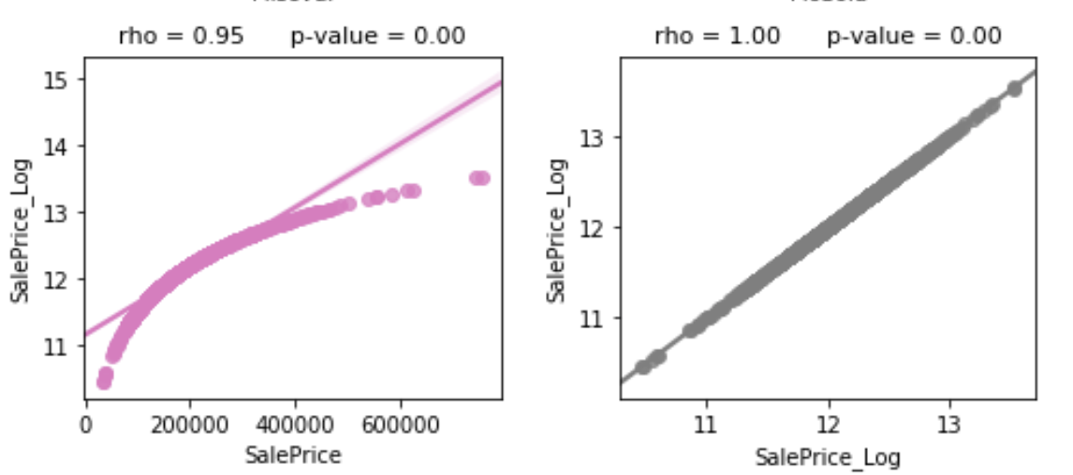
The Target

Slide 24
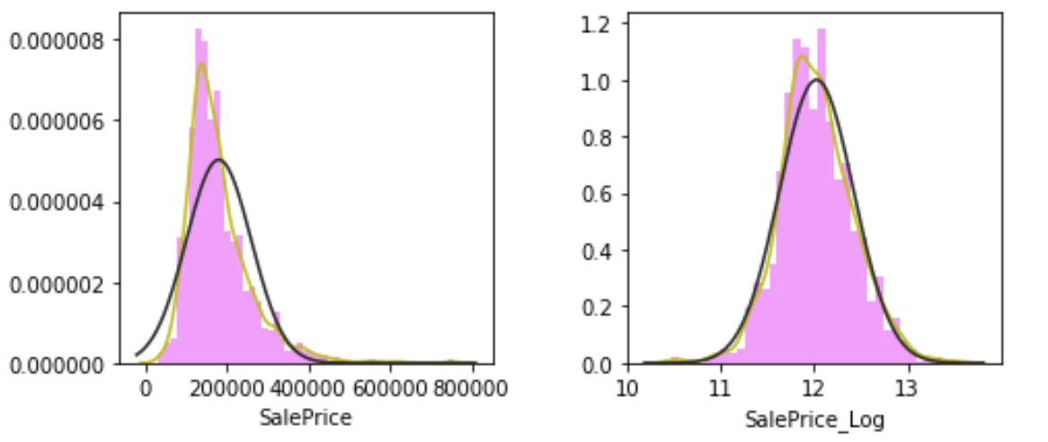
The Target

Slide 25
Feature Engineering
Categorical variables in the Train data set have NAs that represent a factor of ‘None’ => converted to ‘None’
Remaining NA’s were imputed using the mean
Categorical variables that were strongly related to the target were converted to numeric data:
‘MSZoning', 'Neighborhood', 'Condition2', 'MasVnrType', 'ExterQual', 'BsmtQual','CentralAir', 'Electrical', 'KitchenQual', 'SaleType’
Transformed GrLivArea to a log value
Variables which exhibited multicollinearity were removed:
‘GarageArea’, ‘1stFlrSF’, ‘TotRmsAbvGrd’, ‘GarageYrBlt’

Slide 26
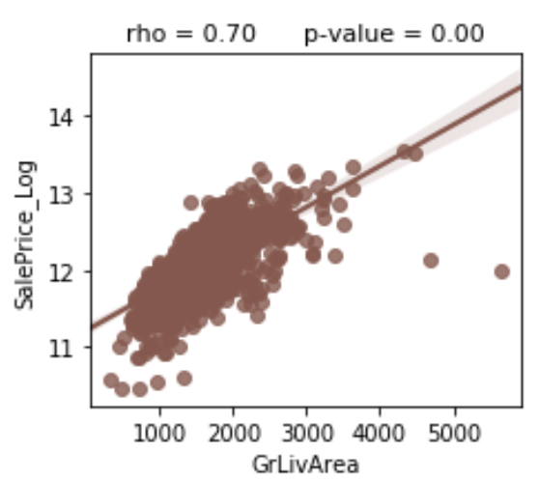
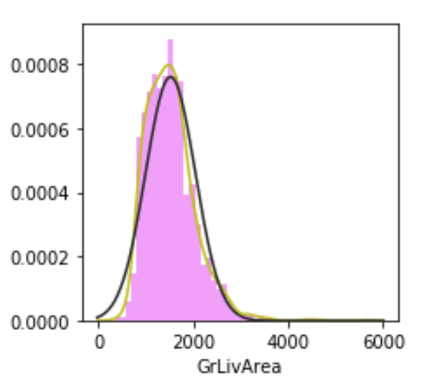
Outliers - Ground Living Area
Remove Outliers with ground living area (”GrLivArea”) square footage in excess of 4,000 and where sale price (“SalePrice”) is less than USD 220,000.

Slide 27
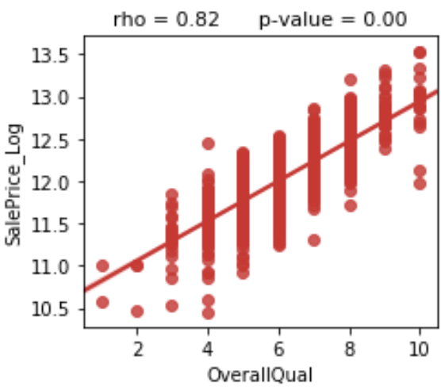
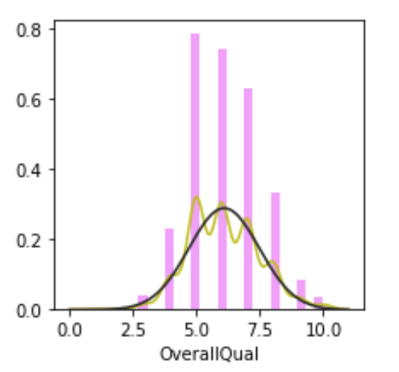
Outliers - Overall Quality
Remove outliers at 10 where SalePrice_Log is less than 12.3.

Slide 28
Modeling Assumptions
For each model, we run GridSearchCV with 5 folds and the following hyperparameters
Linear: | {'copy_X': True, 'fit_intercept': True, 'normalize': False}
Ridge & Lasso: | {'alpha': 0.01, 'normalize': True, 'tol': 1e-06}
ElasticNet: | {'alpha': 0.1, 'fit_intercept': True, 'l1_ratio': 0.04, 'max_iter': 1000000, 'normalize': False, 'tol': 0.0001}
SGD: | {'alpha': 1e-05, 'epsilon': 0.01, 'fit_intercept': True, 'max_iter': 10000}
Decision Tree: | {'max_depth': 9, 'max_features': 10, 'max_leaf_nodes': None, 'min_samples_split': 20, 'presort': True, 'random_state': 5}
Random Forest: | {'min_samples_split': 3, 'n_estimators': 100, 'random_state': 5}
KNN: | {'algorithm': 'brute', 'n_neighbors': 7, 'weights': 'distance'}

Slide 29
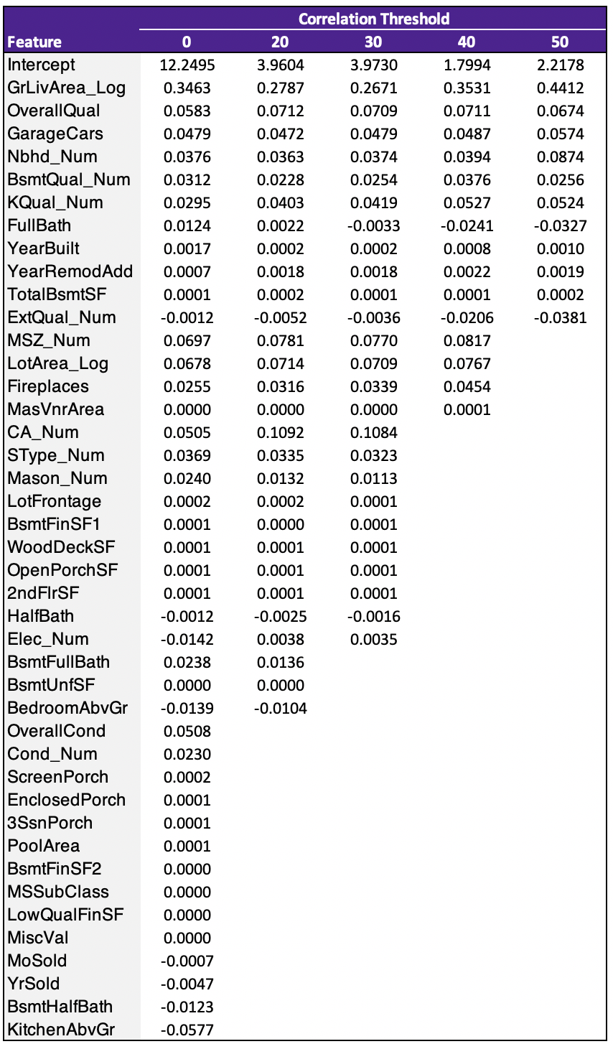
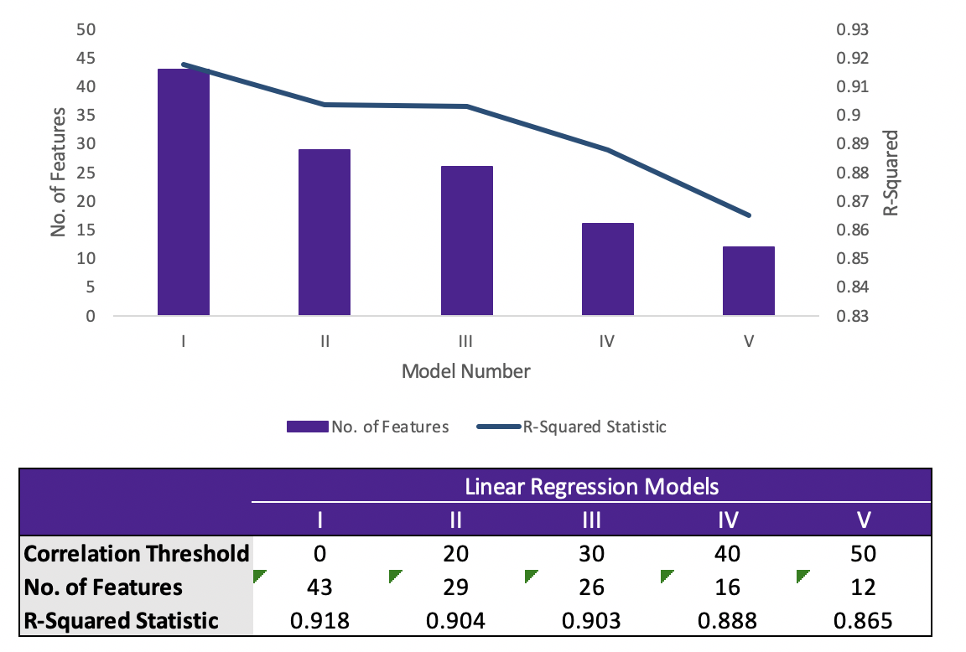
Linear Regression Correlation Rank Reduction Scenario Analysis

Slide 30
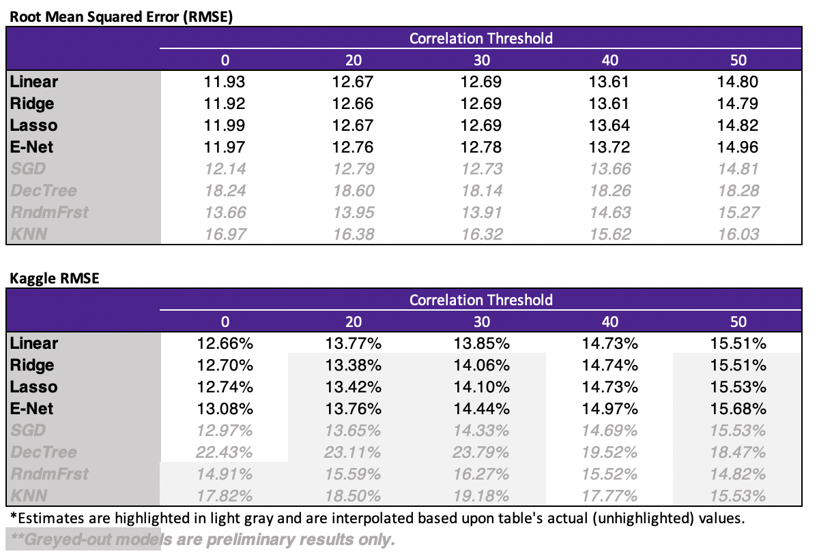
Summary Results

Slide 31
Next Steps
Feature engineering refinement
Review Feature Anti-Selection – Define quantitative selection criteria
Revise multicollinearity treatment for lower correlation threshold scenarios
Model analysis
Hyperparameter tuning

